Slide 1
Concepts in Deep Learning: Representation Learning
Luisa Abels, Laura Hellmann
Deep Leaning by Ian Goodfellow, Yoshua Bengio, Aaron Courville in 2016

Slide 2
Table of Contents
Introduction
Transfer Learning and Domain Adaptation
Semi-Supervised Disentangling of Causal Factors
Distributed Representation
Unsupervised pretraining
Exponential Gains from Depth
Providing Clues to Discover Underlying Causes

Slide 3
Introduction

Slide 4
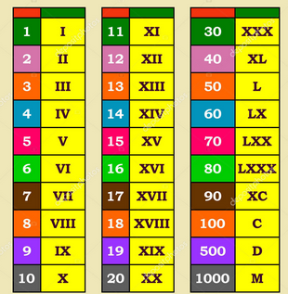
What is Representation Learning?
Everywhere in ML: with every training objective a representation is learned as a side effect
focused on finding most efficient data representation for a given task
Why is it Important?
replaced manual feature engineering
Optimized deep learning processes (e.g. faster, fewer dimensions in model)
Facilitates training with large, unlabeled datasets

Slide 5

Deep Learning and Representations
Lower layers learn simple patterns (e.g., edges in images)
Higher layers capture complex concepts (e.g., object parts)
→ each layer of a neural network refines the data representation from simple to complex
Notes:
Just a quick recap: We all know neural networks with a structure like in the picture where we have an input layer , hidden layers and an output layer. The hidden layers are our feature vectors (each node is one feature) that we want to compress into more meaningful, but abstract features. The feature vector is supposed to be the best representation od the data (features) for the intended task.

Slide 6
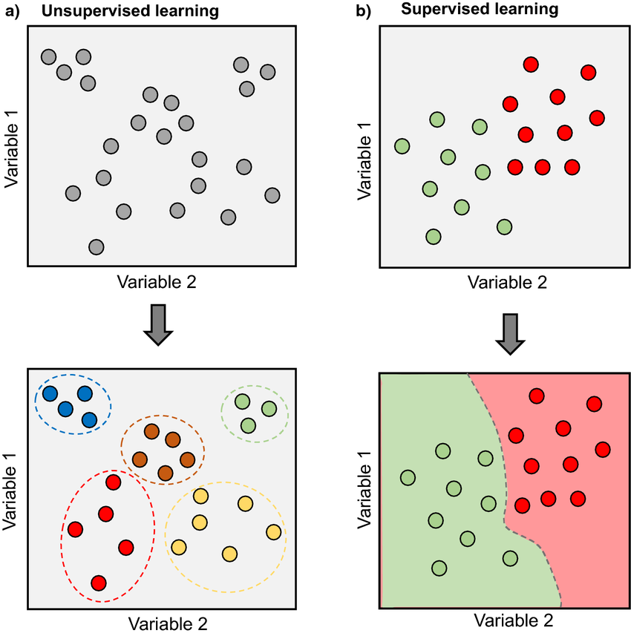
Supervised vs. Semi-Supervised vs. Unsupervised Learning
Supervised Learning:
Guide by labeled data
Semi-Supervised Learning:
Trained with unsupervised and refined with few supervised data
Unsupervised Learning:
Finds natural patterns in data

Slide 7
Unsupervised Pretraining
Historical significance:
Enabled early deep network training without labeled data
Still used in scenarios with sparse labeled datasets
Learns structuring data before applying supervised tasks
“current” problems: overfitting; too specific parameters
Notes:
Okay, now that we

Slide 8
Greedy Layer-Wise Training
Idea: Initializing DNNs by training each layer one-by-one unsupervised and fine tuning the result with supervised learning
Input (X)
train
split
Fine-Tuning
(supervised, backpropa-gation)
Autoencoder 1
Encoder 1
(X -> H1)
Hidden Layer (H1)
Discard Decoder
train
Autoencoder 1
split
Encoder 1
(X -> H1)
Hidden Layer (H2)
Discard Decoder

Slide 9
Greedy Layer-Wise Training
pro | Con
Better initialization | Time-consuming
Solved Vanishing Gradients | Outdated
Unsupervised Learning | Not fully optimal
Better representations

Slide 10
When does unsupervised Pretraining work?

Slide 11
Why does unsupervised Pretraining work?

Slide 12
Transfer Learning and Domain Adaptation

Slide 13
Transfer Learning
Definition: Involves leveraging knowledge from one task or domain (distribution P1) to improve generalization in another task or domain (distribution P2).
→ Use of unsupervised datasets possible (due to training on supervised dataset with similar/shared task)

Slide 14
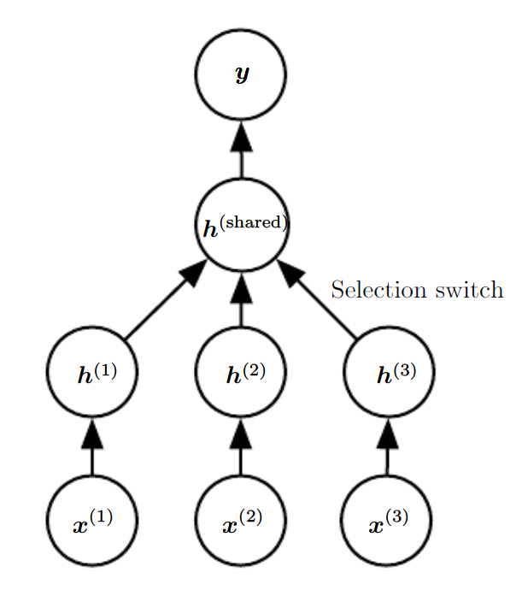
Transfer Learning
Representation shared of semantics of input, but also of output possible
E.g. Speech recognition with valid sentences in output layer, but early hidden

Slide 15
Domain Adaptation
Definition: A specific form of transfer learning where the task remains the same, but the input distribution changes. The model adapts to variations in data distribution across domains.

Slide 16
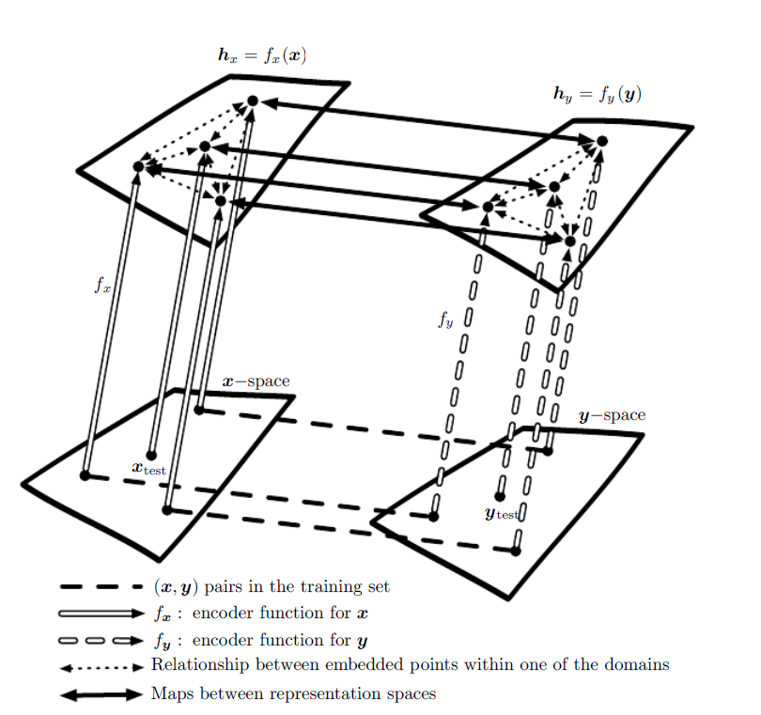
(transfer or domain?) One-shot and zero-shot learning

Slide 17
Semi-Supervised Disentangling of Causal Factors
What Makes a Representation "Good"?:
Disentangled Representations: An ideal representation is hypothesized to be one where the features correspond to distinct underlying causes of the data, making it easier to understand and manipulate the representation.
Causal Factors: A representation that captures the causal factors of observations can simplify subsequent tasks, like inferring conditions or outcomes from the data.

Slide 18
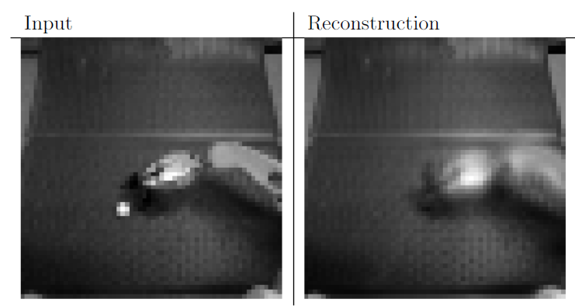

Slide 19
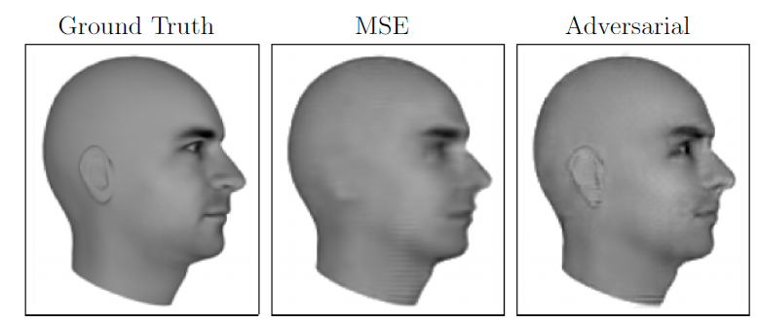

Slide 20
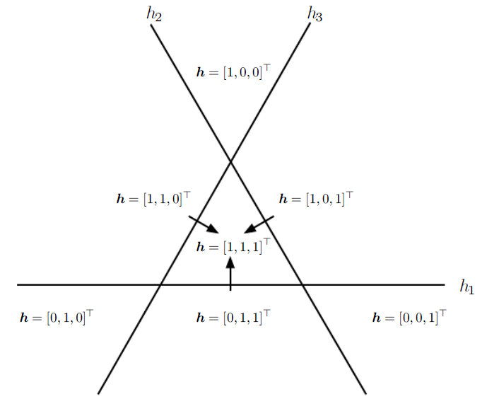
Distributed Representation

Slide 21
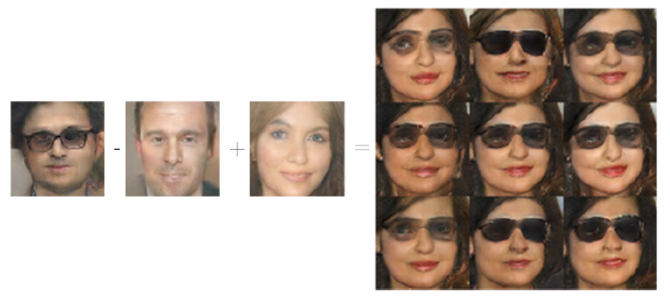
Distributed Representation

Slide 22
Exponential Gains from Depth

Slide 23
Providing Clues to Discover Underlying Causes

Slide 24
Further Research / State of the Art

Slide 25
Conclusions

Slide 26
References

